Slide 1
Functions
CS 0447
Jarrett Billingsley

Slide 2
Class announcements
:V

Slide 3
A frustrating story

Slide 4
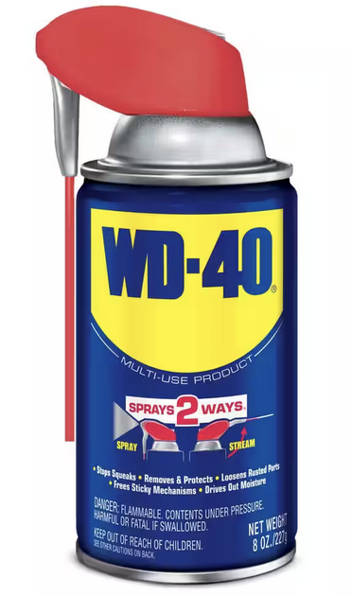
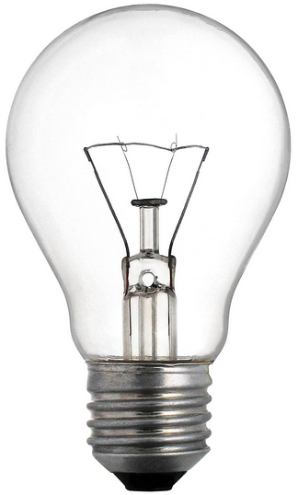
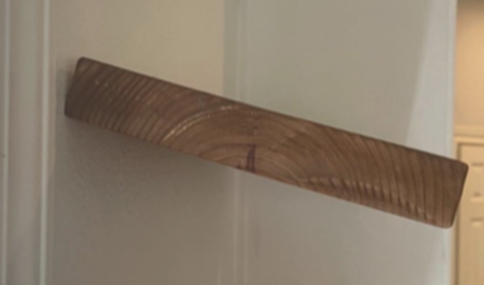
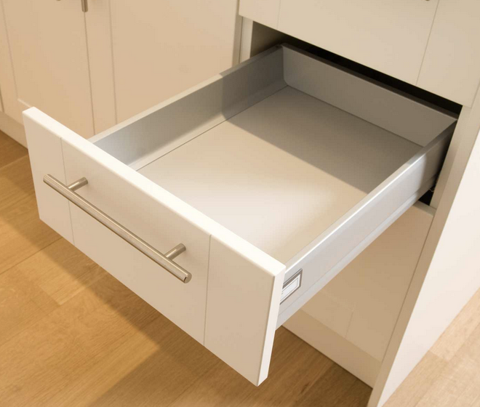


Nothing is ever as simple as you want it to be
you get home and try to turn on the light.
you get a bulb from the closet, but the shelf is slanted.
you get a screwdriver, but the drawer is squeaky.
the lightbulb is burned out.
you get the WD-40, but the can is empty.
you start fixing the car, and end up pulling the entire engine out.
now, what do you have to do, and in what order?
you get in your car to go to the store, but it won’t start.
Notes:
fix the car to go to the store to get WD-40 to oil the drawer to fix the shelf to replace the lightbulb!!!
https://www.youtube.com/watch?v=AbSehcT19u0

Slide 5
The moral of the story
when you are doing task A, and you need to do task B…
  you remember where you were in task A
  and you start task B
when you are done with task B…
  you can forget about task B
  and you resume task A at the point where you paused
and this can keep going!
  task B can have a sub-task C, which has a sub-task D, etc…

Slide 6
In other words…
when the caller calls a function, where do we go?
when the callee is finished, where do we go?
void fork()
{
knife();
spoon++;
}
void knife()
{
spork++;
spatula--;
}
remember: come back to here!
caller
callee
Notes:
- it doesn't matter if you use an explicit return or not…
- when the callee finishes, it goes back to the line after the call in the caller.

Slide 7
Functions

Slide 8
What's a function?
a function is a named piece of code with inputs and outputs.
the name should say what it does.
increment_array
arguments
return value
it can have inputs (arguments, parameters)
it can have outputs (return value, side effects)
there's (obviously) code inside, but it should be treated as a black box.
Notes:
- a method is a special kind of function; function is a more general term
- in OOP, a method is "a function that 'belongs to' an object"
- "a.b()" is kind of like calling "b(a)" where "a" becomes "this" within the method
- but if you have subtyping and virtual methods, "a.b()" is more complex than "b(a)"

Slide 9
Reuse and composition
functions give us flexibility.
we avoid repeating ourselves by calling them more than once.
complex, multi-step tasks can be split into smaller functions.
println
draw_stuff
1
draw_paddles
"hi!"
2
draw_ball
"bye!"
println
3
draw_score
one function's outputs can become another's inputs.
sin
angle
deg_to_rad
rotate
cos
Notes:
- a HUGE part of programming is managing complexity.
- it's far easier to work with tiny, self-contained pieces of code that fit together in neat ways…
- …than it is to work with huge, amorphous functions that can't be reused or reordered easily.

Slide 10
Call and return
a function call pauses the caller and runs the callee to completion.
knife()
this is what a function call looks like in most HLLs.
this is the only thing that is a function call.
you cannot use the verb "call" to mean anything else.
...code...
}
return
a function return stops running the callee and resumes the caller.
it's still called a return even if you "hit the end of the function."
Notes:
- these vocabulary words are absolutely essential to use correctly in CS. do not misuse them.
- it would be like calling a molecule an "element" or something

Slide 11
Call graphs
Finish by :35

Slide 12
The Digraph of Life
a call graph is a diagram of which functions call one another.
main
main
main
convert_file
...
...
println
prompt
println
readln
read_file
convert_values
output_values
a function that calls no functions is a leaf function
I don't think there's a name for the other kind. maybe "tree function?"
what would a recursive function look like?
Notes:
- first one is a "Hello world"
- second one is a slightly more complex program
- third one is just part of a larger program, like your project will be
- a recursive function would point to itself!

Slide 13
BAD GRAPH, BAD GRAPH
what you absolutely do not want is this
main
this is called spaghetti code
we literally invented functions and control structures to avoid this confusing mess
convert_file
interactive
output_values
never, ever think "what function do I go to next?"
it will only confuse you!
??????
Notes:
- this applies to HLLs too!!
- I see a LOT of people in e.g. 449 calling "the next" function at the end of each function, and it's wrong, always

Slide 14
The shape of a program
many programs are hierarchical in nature. (but definitely not all of them)
in that case, the call graph can be shown as an outline:
main
get_input
each function is responsible for one task
update_paddles
check_edge
none of the functions needs to know what happens after them!
update_ball
hit_walls
hit_paddles
"what happens next?" comes "for free" because you call the functions in the order you want them to run.
draw_stuff
wait_for_next_frame
Notes:
- programs which aren't hierarchical are better represented using concurrency or coroutines
- concurrency is usually done with multiple threads or processes – two or more functions running at the same time
- coroutines haven't historically been very common but are becoming more popular
- instead of function A waiting for function B to finish…
- coroutine A and coroutine B can pass control back and forth without either one finishing

Slide 15
Top-down design and stubbing-out
you can design a complex program with an outline like that.
you start from the top – the most abstract – and work down.
void main() {
while(playing) {
get_input();
update_paddles();
update_ball();
draw_stuff();
wait_for_next_frame();
}
}
now I stub out each of these functions. a stub is just an empty function.
then, I can work on each function a little, test, work on the next one, test, etc.
this leads to a very organized program that is easy to read, debug, and change!
void get_input() {}
void update_paddles() {}
...
Notes:
- this has really improved the quality of my own code. you should really try it as your programs get bigger!!!
- each function reads like English, and I can see at a glance what happens and in what order.
- if I have a bug, it's much easier to track down where the bug is, because I know the only places it could be happening.
- if I want to reorder the steps or add new ones, it's super easy cause it's just changing single lines.

Slide 16
Implementing Functions

Slide 17
The basics
modern ISAs evolved to implement function calls efficiently.
there are three important building blocks:
an instruction to call a function
func()
an instruction to return to the caller
return
some way to implement a stack
push
pop
but what about all the other stuff? arguments, return values, variables…?
well… we have to implement that.
Notes:
- very old ISAs developed before HLLs and functions were in widespread use lacked some or all of these features
- but unless you're an enthusiast for computers from the 1960s and earlier, you'll probably never encounter one

Slide 18
Calling conventions
a calling convention is a set of rules used to write and call functions.
it's an honor system: the rules guide us, but they're not automatic.
calling conventions specify:
how arguments are passed…
func
how values are returned…
how control flows into and out of the callee…
and other things like local variables, stack frames, and register saving rules. (huh?)
Notes:
- …we're not gonna learn every part of the MIPS calling convention, just the important and relevant parts.

Slide 19
The program counter register
machine code instructions are in memory, so they have addresses
the program counter (PC) is the address of the current instruction
time
pc
_top:
0x8000 | lw t0, (s0)
0x8004 | add t0, t0, 1
0x8008 | sw t0, (s0)
0x800C | add s0, s0, 4
0x8010 | blt s0, s1, _top
0x8000
0x8004
0x8008
0x800C
0x8010
0x8000
?
0x8014
btw what pattern do you notice about these addresses?
Notes:
- basically, the PC says "what step are we on?"
- and by changing the PC, we can change what step we're on – that's control flow
- you can see the pc register at the bottom of the registers pane in MARS, and when you single-step, you can watch it change
- a conditional branch can set the PC to one of two values – the branch target (its label), or the next instruction.
- the addresses are multiples of 4 (end in 0, 4, 8, C in hex)
- this means instructions are 4 bytes each, so they are 4 byte aligned.

Slide 20

The return address register
ra stands for return address, and it's like a bookmark.
you bookmark your position,
and then read the other book…
you're reading, and it
references another book.
ra
see TAPL
pp. 407-408
407
408
and when you're done, you go back to the bookmark.
BUT YOU ONLY HAVE ONE BOOKMARK.
Notes:
KEEP THAT IN MIND

Slide 21
Calling and returning in MIPS
it's deceptively simple!
func()
jal func
return
jr ra
jal stands for "jump and link"
jr stands for "jump to register"
every function except main must return using exactly one jr ra, located at the end of the function.
Notes:
- nothing is stopping you from putting multiple jr ra in a function, but it's gonna be horrible if you do! so don't!

Slide 22
So what do jal and jr do?
all jumps unconditionally copy an instruction address into the PC.
jal copies the label address into pc…
…and sets ra to the address of the instruction after jal
fork:
...
jal knife
add s0, s0, 1
...
knife:
lw t0, spork
add t0, t0, 1
sw t0, spork
jr ra
ra
jr ra copies the value of ra into pc, which follows the link back to the caller.
Notes:
- regular "j" just copies a label address into the PC. that's it.
- jal and jr ra go together like bookends.

Slide 23
BRANCHES DO NOT DO THIS.
I’m not really sure why this has become such a common mistake on the exams the past few terms but:
jal is the only instruction that remembers where to come back to by putting that info in the ra register.
branches (beq, blt, etc.) do not do this!
Notes:
- so if you get an exam question asking you to describe what branches do… now you know what NOT to write!

Slide 24
Passing arguments and returning values

Slide 25
How did you write syscalls?
a syscall is a weird kind of call, but when you pass an argument…
  what register(s) do you put them in?
and when you get a value back (like the "read int" syscall in lab 2)…
  what register do you get the value back in?
a0-a3 are the argument registers
v0-v1 are the return value registers
  syscall annoyingly misuses v0 as an "argument" to choose which function to run which confuses everyone
this is just part of the calling convention
  there's nothing special or "automatic" about these registers
  but we write all our functions to assume that this convention is being followed; and as long as every function does, it works out.

Slide 26
Getting and giving values
if we have a function in a higher level language…
v0
a0
a1
the two arguments will be passed into this function in a0 and a1.
  int gcd(int a, int b) {
  while(a != b) {
  if(a > b)
  a -= b;
  else
  b -= a;
  }
  return a;
  }
for this, just put the value you want to return in v0 before jr ra.

Slide 27
Input, output
let's write a function like this:
int add_nums(int x, int y) { return x + y; }
inside of our add_nums asm function…
  which register represents x?
  which register represents y?
  which register will hold the sum that we return?
  add_nums:
  add __, __, __
v0
a0
a1
jr ra
Notes:
- this is the softest of softballs. cmon

Slide 28
Calling that function
now let's make main do this:
  print_int(add_nums(3, 8))
how do we set 3 and 8 as the arguments?
how do we call add_nums?
afterwards, which register holds the sum?
so how can we print that value?
why do syscalls put the number of the
syscall in v0?
  well what do you get when you cross an elephant and a rhino?
    hell if I know
li a0, 3
li a1, 8
jal add_nums
move a0, v0
li v0, 1
syscall
Notes:
- return value always comes out in v0, but argument needs to be in a0… move to the rescue!
- get it? eleph-ino? hell if I know? GET IT???????

Slide 29
An issue.

Slide 30
YOU ONLY HAVE ONE BOOKMARK
let's track PC and ra as we run this code.
PC
ra
0x8000 | jal fork
0x8004 | li v0, 10
... | ...
0x8020 | jal spoon
0x8024 | jr ra
... | ...
0x8040 | jr ra
0x8000
0x0000
After jal fork:
0x8020
0x8004
After jal spoon:
0x8040
0x8024
fork:
After jr ra:
0x8024
0x8024
After jr ra:
0x8024
0x8024
UHHHHHHHH
spoon:
After jr ra:
0x8024
0x8024
After jr ra:
0x8024
0x8024
After jr ra:
0x8024
0x8024
After jr ra:
0x8024
0x8024

Slide 31
What's the deal? (animated)
there's only one return address register.
ra
we lost our way back to the first book.
and now we're stuck in an infinite loop.
with one return address register, we can only go one function call deep!
Notes:
- if only there were a way to remember arbitrarily many return addresses 😔

