Slide 1
Numerical Representation and Unsigned Integers
CS 0447
Jarrett Billingsley

Slide 2
Class Announcements
repeat after me:
  1 byte is 8 bits
there are exercises that go with each lecture!
  go to my page, Materials, then Exercises

Slide 3
Binary

Slide 4
Positional number systems
the numbers we use are written positionally: the position of a digit within the number has a meaning
Most Significant
Least Significant
1,234
=
1 × 10³ +
2 × 10² +
3 × 10¹ +
4 × 10⁰
1000s
100s
10s
1s
10³
10²
10¹
10⁰
how many digit symbols do we have in our number system?
  10: 0, 1, 2, 3, 4, 5 ,6 ,7, 8, 9

Slide 5
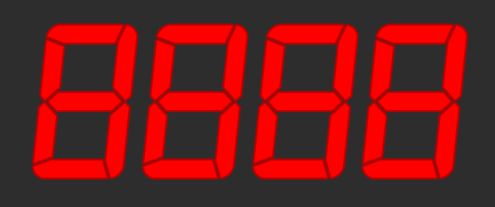
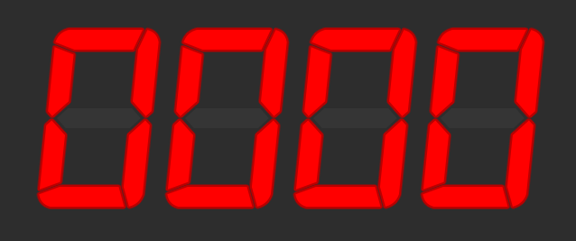
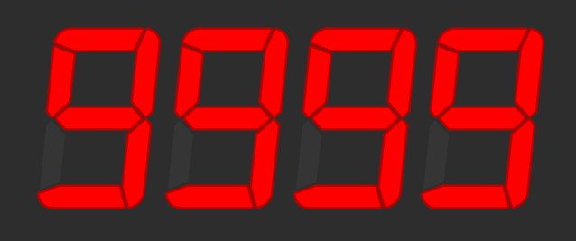
Range of numbers
suppose we have a 4-digit numeric display
what is the smallest non-negative integer
it can show?
what is the biggest integer it can show?
how many different values can it show?
  9999 - 0 + 1 = 10,000
what power of 10 is 10,000?
  10⁴
let's generalize. with n digits:
  how many values can we show?
    10^{n}
  what is the largest integer we can show?
    10^{n}-1
Notes:
- smallest is 0
- biggest is 9,999

Slide 6
Numeric Bases
we use a base-10 (decimal) numbering system
but we can use (almost) any number as a base!
the most common bases when dealing with computers are base-2 (binary) and base-16 (hexadecimal)
when dealing with multiple bases, you can write the base as a subscript to be explicit about it:
5₁₀ = 101₂
Notes:
- you can have irrational bases! sure! why not!!!!!!

Slide 7
Rules for Bases
given base B,
  there are B digit symbols
  each place is worth B^{i}, starting with i = 0 on the right
  given n digits:
    you can represent B^{n} different values
    the largest representable integer is B^{n} – 1
so how about base-2?
  how about with… 5 binary digits?
Notes:
- base 2 has 2 digit symbols (0, 1)
- places are worth 2^0, 2^1, 2^2… = 1, 2, 4, 8, 16…
- with 5 bits:
- 2^5 (32) numbers
- max is 2^5-1 = 31

Slide 8
Binary (base-2)
we call a binary digit a bit – a single 1 or 0
when we say an n-bit number, we mean one with n binary digits
MSB LSB
1 × 128 +
0 × 64 +
0 × 32 +
1 × 16 +
0 × 8 +
1 × 4 +
1 × 2 +
0 × 1
= 150₁₀
1001 0110
=
2⁷ 2⁶ 2⁵ 2⁴ 2³ 2² 2¹ 2⁰
128s 64s 32s 16s 8s 4s 2s 1s
to convert binary to decimal: ignore 0s, add up place values wherever you see a 1.
Notes:
MSB and LSB are most/least significant bit
the space between the two groups of 4 bits is just for readability, like how we put commas in decimal numbers (1,234).
- you gotta know these powers of 2! YOU GOTTA!

Slide 9
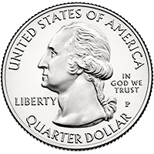
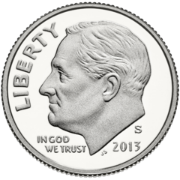
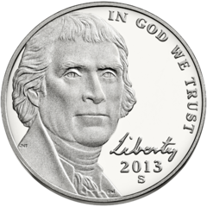
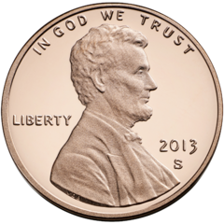
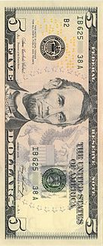
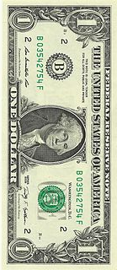
Making change
you want to give someone $9.63 in change, using the fewest bills and coins possible. how do you count it out?
$5× $1× 25¢× 10¢× 5¢× 1¢×__
1
4
2
1
0
3
left:
$9.63
-$5=
$4.63
-$4=
$0.63
-50¢=
$0.13
-10¢=
$0.03
-0¢=
$0.03
-3¢=
$0.00
biggest to smallest
most significant to least significant
WHERE COULD THIS BE GOING...
Notes:
- doooooes this process remind you of anything? ;O
- maybe long division?

Slide 10
Converting decimal to binary
you want to convert the number 83₁₀ to binary.
128s
64s
32s
16s
8s
4s
2s
1s
left:
83
83
19
19
3
3
3
1
0
- 0 =
- 64 =
- 0 =
- 16 =
- 0 =
- 0 =
- 2 =
- 1 =
0
1
0
1
0
0
1
1
for each place from MSB:
  if place value ≤ remainder:
    digit = 1
    remainder = remainder - place
  else, digit = 0.
it's like long division!
Notes:
- see how binary makes this so simple: it reduces this "division" problem to a sequence of yes/no questions
- having only 0 and 1 makes a lot of things simpler… think about how simple binary multiplication would be!

Slide 11
Bits, bytes, nybbles, and words
8 bits (8b) = 1 byte (1B)
do not confuse nybbles with bytes!
bit number: | 7 | 6 | 5 | 4 | 3 | 2 | 1 | 0
 | 1 bit | 1 bit | 1 bit | 1 bit | 1 bit | 1 bit | 1 bit | 1 bit
4 bits (4b) = 1 nybble
another nybble
also, most things are measured and manipulated in multiples of bytes, not bits.
a word is the "most comfortable size" of integer for a CPU. that means the size of numbers it can operate on.
when we say ”64-bit CPU," we mean its word size is 64 bits.
Notes:
we number bits from 0 at the LSB upwards to the left, since those are the powers of the place.
some old diagrams go the other direction, but that’s just silly and hasn’t been done in decades.
a byte is usually the smallest unit of measurement. nybbles and bits are just parts of bytes.
note: in some contexts, “word” has a non-standard meaning, typically “a 16-bit number.” this is mostly a historical quirk of x86 and Windows and is super confusing and man are computer scientists bad at naming things and being consistent with those names

Slide 12
The Big Thing
everything on computers is encoded in binary.
every variable you have ever declared, every number you have typed in and printed out, every string, object, file, image, sound, video, program, document…
  everything is a sequence of 0s and 1s.
why binary? cause it's easy.
  easy to make circuits, easy to do math, and easy to make it run fast.
in computer science (and many other areas), it’s often best to do the simplest thing that works, and build everything else on top of that.
  we don’t need base-10 computers, because base-2 computers are simpler, and conversion between base-2 and base-10 is easy.
Notes:
it’s much easier to distinguish between one of two possibilities than, say, one of ten possibilities. that’s really the fundamental reason binary circuits are easier to make/run faster than base-10 circuits.
we sure tried making base-10 computers, for many years, in mechanical, electromechanical, and electronic forms. but ultimately the speed and implementation simplicity of binary won out.

Slide 13
Hexadecimal

Slide 14
Shortcomings of binary and decimal
Binary numbers can get really long and really unreadable.
  3,927,664₁₀ = 11 1011 1110 1110 0111 0000₂
But powers of 2, which look nice in binary, look arbitrary in decimal.
  1000000000000000₂ = 32,768₁₀
What we want is an auxiliary base, one which makes powers of 2 look nice, but which is more compact than binary.
  It’s not just for aesthetics; it’s about revealing patterns.
To do this, we could pick any base which is itself a power of 2, like base-4, base-8, base-16, base-32, etc.
  base-4 is not much terser than binary
    3,927,664₁₀ = 120 3331 2323 0000₄
  base-32 would require 32 digit symbols
  but base-8 and base-16 look promising!
    (spoilers, no one uses base-8 (octal) anymore)
Notes:
- the "arbitrary look" of decimal is because 10 is not a power of 2 – there's that factor of 5 in there
- in C, C++, Java, I think C# and many others, a numeric literal that starts with 0 is in octal
- it was useful on 9-, 12-, 18-, and 36-bit machines
- but those haven't existed in decades
- DNA uses base 4 with a word size of 3 digits! tho we write the digits as "ACGT"
- each "codon" (word) of 3 digits represents one amino acid in a protein chain
- 64 codons map to ~22 amino acids, for some redundancy
- start and stop codons exist too – and likely all sorts of other things, like control flow (decision making)

Slide 15
Let's make a base-2 16 number system
here are the rules again:
  given base B,
    there are B digit symbols
    each place is worth B^{i}, starting with i = 0 on the right
    given n digits:
      you can represent B^{n} different values
      the largest representable integer is B^{n} – 1
so how about base-16?
  how about with 4 hex digits?
Notes:
- there are 16 digit symbols (0-9, and then A-F)
- places are 16^0, 16^1, etc (1, 16, 256, 4096 – interestingly all end in 6 in decimal)
- 4 hex digits = 16^4 numbers = 65536 numbers
- biggest is 65535

Slide 16
Hexadecimal or "hex" (base-16)
digit symbols A, B, C, D, E, F mean 10, 11, 12, 13, 14, 15
we call one hexadecimal digit a hex digit. or a nybble?
0 × 16⁷ +
0 × 16⁶ +
3 × 16⁵ +
11 × 16⁴ +
14 × 16³ +
14 × 16² +
7 × 16¹ +
0 × 16⁰ =
3,927,664₁₀
003B EE70
=
16⁷ 16⁶ 16⁵ 16⁴ 16³ 16² 16¹ 16⁰
to convert hex to decimal: use a dang calculator lol
(or, convert to binary, then to decimal)
Notes:
- ACE are even, BDF are odd
- you can kiiiiinda do bytes in your head (2-digit hex numbers) since that only needs one multiplication by 16 but still

Slide 17
The magical relationship
4 bits (1 nybble) are equivalent to 1 hex digit
1 byte = 8 bits and therefore 2 hex digits (or 2 nybbles)
how many hex digits is a 32-bit number?
how many bits is a 5-digit hex number?
0xB8 = 1011 1000₂ = 184₁₀
(this is common notation for hex, derived from the C language. it’s NOT part of the number.)
these are three ways of representing the same value.
they're different views of the same data.
Notes:
- 32 bits = 8 hex digits
- 5 hex digits = 20 bits

Slide 18
Converting between binary and hex
say we had this binary number:
1110111110111001110000₂
starting from the LSB (right side):
  divide into groups of 4 bits (nybbles)
    (add 0s to the left if needed)
  convert each nybble to 1 hex digit
0011 1011 1110 1110 0111 0000
Bin | Hex | Bin | Hex
0000 | 0 | 1000 | 8
0001 | 1 | 1001 | 9
0010 | 2 | 1010 | A
0011 | 3 | 1011 | B
0100 | 4 | 1100 | C
0101 | 5 | 1101 | D
0110 | 6 | 1110 | E
0111 | 7 | 1111 | F
0x
3
B
E
E
7
0
hex → binary? look at the table and go the opposite way!
know this table.
Notes:
- 4 bits = 1 hex digit = 4 bits, so all you need is this table to translate between em
- it's easy to recover the table if you forgot it: count in binary up to 15 and write the hex digits next to em
- I kinda remembered A=1010, and then counted up from there to remember lol
- since this is 6 hex digits, how many BYTES is it? (3)

Slide 19
Powers of Two
 | Dec | Hex
2⁰ | 1 | 0x1
2¹ | 2 | 0x2
2² | 4 | 0x4
2³ | 8 | 0x8
2⁴ | 16 | 0x10
2⁵ | 32 | 0x20
2⁶ | 64 | 0x40
2⁷ | 128 | 0x80
 | Dec | Hex
2⁸ | 256 | 0x100
2⁹ | 512 | 0x200
2¹⁰ | 1,024 | 0x400
2¹² | 4,096 | 0x1000
2¹⁶ | 65,536 | 0x10000
2²⁰ | 1,048,576 | 0x100000
2³¹ | 2,147,483,648 | 0x80000000
2³² | 4,294,967,296 | 0x100000000
2⁸-1 = 255 = 0xFF =
max value of an
unsigned byte
1ki (like kibibyte)
1Mi (like mebibyte)
2³¹-1 = 2,147,483,647 =
0x7FFFFFFF =
max value of a
Java int
  memorize at least the powers up to 2¹⁰
Notes:
- if you can't remember a power of two, add the previous one to itself!
- notice the hex versions are nice round numbers with a repeating pattern
- if you see numbers like this, you can visualize them as a 1 with 0s after

Slide 20
Unsigned Integers and the limits of computers

Slide 21
Number line segment
let’s look at the integers you can make with 4 bits on a number line.
0000
0001
0010
0011
0100
0101
0110
0111
1000
1001
1010
1011
1100
1101
1110
1111
0
1
2
3
4
5
6
7
8
9
10
11
12
13
14
15
there are two weird things about this number line:
1. where are the negatives?
2. where are the numbers after 15?
we’ll come back to question 2 shortly, but the answer to question 1 is: there are no negatives. these are unsigned integers.

Slide 22
Unsigned Integers
in some programming languages, there are two “flavors” of integers: signed and unsigned. (not Java! Java only has signed integers.)
  signed integers can hold positive or negative values.
  unsigned integers can only hold non-negative values.
  so, unsigned integers correspond to the Natural numbers (ℕ).*
it might seem strange to have this distinction, but unsigned numbers come up a lot, especially when you are counting things.
  think about Java arrays... can arrays have a negative length? are you allowed to access negative array indexes?
going forward, we will be seeing this distinction in a number of places, especially in arithmetic.
Notes:
*…unfortunately there are two definitions of the Naturals, one which includes 0 and one which doesn’t, but go complain to mathematicians about that. “the set of naturals including 0” can be written ℕ₀ or ℕ⁰

Slide 23
Adding in binary (animated)
it works the same way as you learned in school
  except instead of carrying at 10, you carry at 2!
    1 + 1 = 10₂ (2₁₀)
    1 + 1 + 1 = 11₂ (3₁₀)
let's try it. (what are these numbers in decimal?)
1
1
1
1010 1110
+0010 1100
1
1
0
1
1
0
1
0
Notes:
- they are 174 + 44 = 218

Slide 24
Nothing in the real world is infinite.
is there a “biggest number”?
well, in reality, computers are finite. we are finite. neither we nor computers can store infinite amounts of information.
so here’s a really big important thing to remember:
  on computers, integers have a fixed number of bits, and therefore have a limited range of representable numbers.
did you ever learn in Java that there are other integer types besides int? byte, short, and long?
  they’re all integers, but they have different numbers of bits.
    byte = 8, short = 16, int = 32, long = 64
it’s up to you as the programmer to decide in advance how many bits – and therefore the range – you need.
  but in a lot of cases int is just fine
Notes:
go back to your CS 0007/0401 book and look probably in the first chapter – it details the sizes and ranges of the integer types.
and now you know why the ranges seem so arbitrarily chosen. it’s because they’re derived from base 2, not base 10!

Slide 25
The other end of the number line
if integers are a fixed number of bits…
  then the number line is finite, and there is a ”biggest number”.
  e.g. in Java, Integer.MAX_VALUE is the biggest int.
so uh, what happens if you try to go past it?
0000
0001
0010
0011
0100
0101
0110
0111
1000
1001
1010
1011
1100
1101
1110
1111
0
1
2
3
4
5
6
7
8
9
10
11
12
13
14
15
all the numbers past the ends of the number line are unrepresentable, and attempting to compute them will give you… strange results. what is 1111₂ + 0001₂?
in Java, try printing Integer.MAX_VALUE + 1!
Notes:
- 1111₂ + 0001₂ = 10000₂, but that’s 5 bits, not 4. what we do in this situation is something we’ll touch on next time, and get into more detail later in the course.

