Slide 1
Welcome Fall 2024!
CS 0447
Jarrett Billingsley

Slide 2
Class announcements
I will not post these powerpoint slides until... later
(unless you have a DRS exception)
it might be a few days, or a week, or not until review time. not sure.
so if you miss class, it’s your responsibility to get notes from someone else
once I do post them, be sure to check the notes on each slide
for extra explanations, examples, snarky comments etc.
as well as answers to (some of) the questions on the slides so you can study.
Notes:
- yahaha! you found me! I'm a slide note!

Slide 3
Administrivia Finish by :38

Slide 4
hi
you can just call me Jarrett
jarrett@cs.pitt.edu
sites.pitt.edu/~jfb42
Office hours: Tue/Thu 2:00-3:50 in 6509 SENSQ (directions on my site)
Religious absences: contact me ASAP
Students with disabilities: contact the DRS ASAP
Everything in this section is also on my site in "course info"!
I use red on the slides for really important things
Also when I do *this* with my hands, it means I want you to just say something out loud, not putting your hands up.
Let’s try it. 2 + 2 = …?
Notes:
- *this* = me putting both my hands out, palms up, like I’m offering you something.

Slide 5
Communication
I send announcements through Canvas which come through email
it is not my responsibility to make sure you get them, it’s yours
Canvas is for announcements and grades.
almost everything else is on my site, including the course schedule/syllabus.
I think I’ll use Gradescope this term for assignment submissions
Discord hours: yes
For more "official" communications, or if you need my attention immediately, use email.
if you’re asking for an extension, want to schedule a meeting, something serious happened in your life etc. please email me.
otherwise, Discord is preferred – it’s much better for sharing code, screenshots, etc. in a much quicker way.
lab 0 will make sure you get comfortable with it!

Slide 6
Etc etc.
uhhhhh as of the time I’m making these slides I have no idea who my TAs are so I don’t know if recitation starts this week.
let’s look at the textbook, grading, late and submission policies…
you are a student. you are supposed to be confused.
I wanna help you understand! even if it seems like I’m yelling or angry or intimidating or annoyed or whatever.
never say "this is a dumb question" cause there aren't any!
DON’T STRUGGLE IN SILENCE!!!! EVER!!
also, studying together is not cheating! do it!

Slide 7
Academic Integrity
let’s look at the academic integrity policy!
Don't cheat if your enrollment is contingent upon your GPA.
or your ROTC or your student visa or your graduation or your internship or your parents giving you money or or or… or whatever.
you’re an adult, and are responsible for your actions.
I hate being in a position where I have your future in my hands…
especially when you're the one who put it there.
Do not take advantage of my trust.
If you're confused, don't cheat, ask for help.

Slide 8
What, Why, and How
for every topic, ask yourself (and me!) these questions:
Why do we use it?
"splitting code into functions makes it easier to read, understand, and reuse."
What is it?
"a function is a named piece of code."
"in Java, you write the return type, then the name, then a left parenthesis, then any arguments, with the type and name, separated by commas, then a right parenthesis, then…
How do we do it?
what and why are almost always more important than how.
on the exams, be sure you are answering the right question. if I ask "what is X," don't explain how to X.
Notes:
- it's so easy as an instructor to fall into the trap of explaining the How in tons of detail without giving any context.
- the "how" can have a million different answers. what's more important that you understand the ideas behind it.

Slide 9
Introduction and Context

Slide 10
The "what" and "why" of this course
447 teaches you the software and hardware foundations of the computational model that every computer today uses. things like:
how data (numbers) are represented and manipulated
how programs are built out of simple instructions the CPU can run
what a CPU is, and what parts it has
how a CPU actually runs programs
why are you made to take this course?
well why do car mechanics have to learn about how engines run?
so far, you've only learned what computers and programming are.
this entire course is how they work.
as for "why use a computer?"
…good question, and one that I don't think people ask enough.
Notes:
computers suck

Slide 11
Where does this material fit in with CS and EE?
where CS and EE overlap: the “hardware-software interface”
each layer affects/is affected by layers above and below
ISA: Instruction Set Architecture
software interface to the computer hardware
the “building blocks” of software
Logic Design
building computers out of boolean logic functions
the “building blocks” of hardware
Computational Theory
Algorithm Design
Applications
Operating Systems
ISA
Logic Design
Electrical Design
Physics
more abstract more concrete

Slide 12
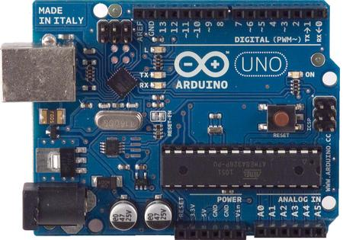
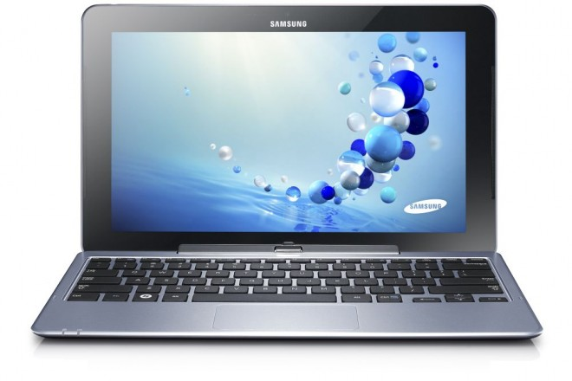
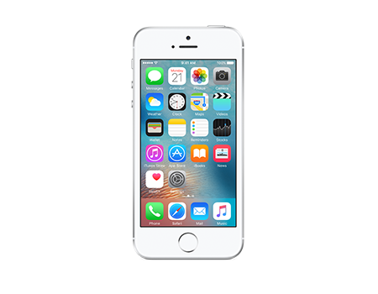
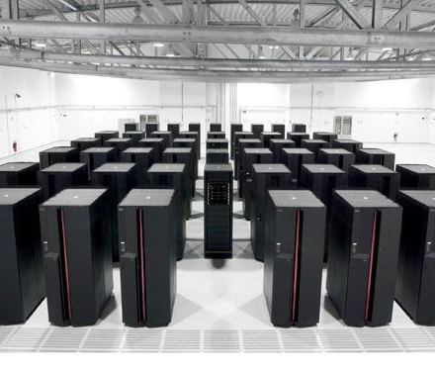
Classes of computers
modern computers span a huge range of sizes and capabilities.
microcontrollers: what makes your thermostat and dishwasher work
servers: they make the internet work
consumer-grade: PCs, laptops, tablets, and phones
supercomputers: how we predict the weather, do science, and waste power on STONKS
Notes:
- seriously we waste so much power on stock trading and cryptocurrency. SO MUCH.

Slide 13
But no matter what…
they all have the same basic organization.
RAM
Persistent Storage
Control
Registers
Other Peripherals
ALU
Processor (CPU)
Working Memory
Input and Output
these are our focus for this course.

Slide 14
ISAs by the way, you should study this section for the exam, everyone always forgets to :^)

Slide 15
Instruction Set Architecture (ISA)
an ISA is a document that specifies the interface that a CPU presents to the programmer
when we say "architecture," this is what we mean
this document defines many things, such as:
what the CPU can do (add, subtract, call functions, etc.)
what registers it has
the machine language
but it does not define how to design the hardware!
…if there's any hardware at all ;)
Notes:
- it's like a Java interface – just says WHAT it does and what expectations there are… doesn't define implementation
- and speaking of Java, the Java Virtual Machine is an ISA that has no hardware (well, with a couple minor exceptions).

Slide 16
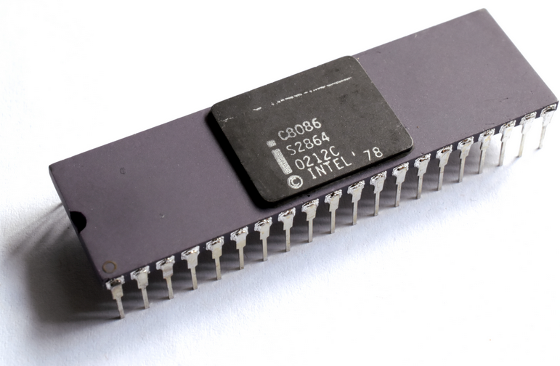
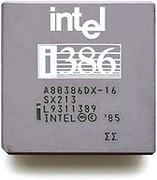
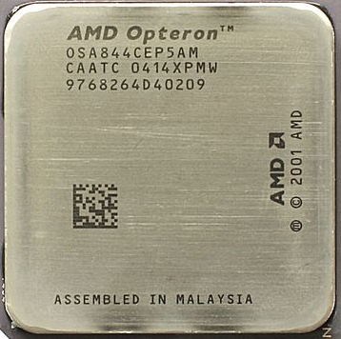
An ISA example: x86
descended from 16-bit 8086 CPU from 1978
extended to 32 bits (1985), then 64 bits (2000)
each version can run all programs from the previous version
you can run programs written in 1978 on a brand new CPU!
so why don't we learn x86 in this course?
it can do a lot of things
its machine language is very complex
we'd have to work around a lot of old, outdated features
you all have different platforms (OSes)
and x86 may be on its way out…
ultimately, we would waste a ton of time

Slide 17
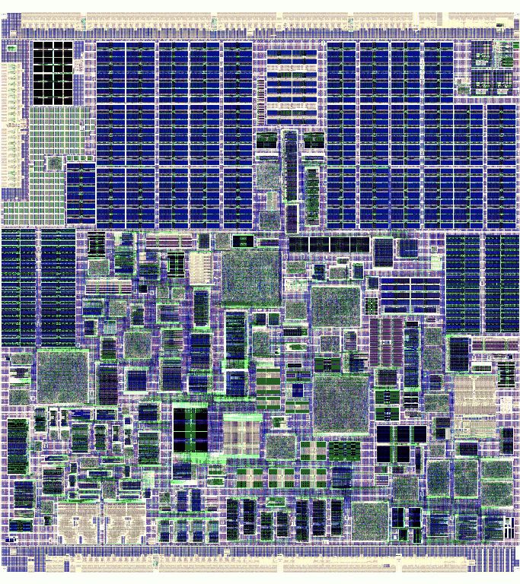
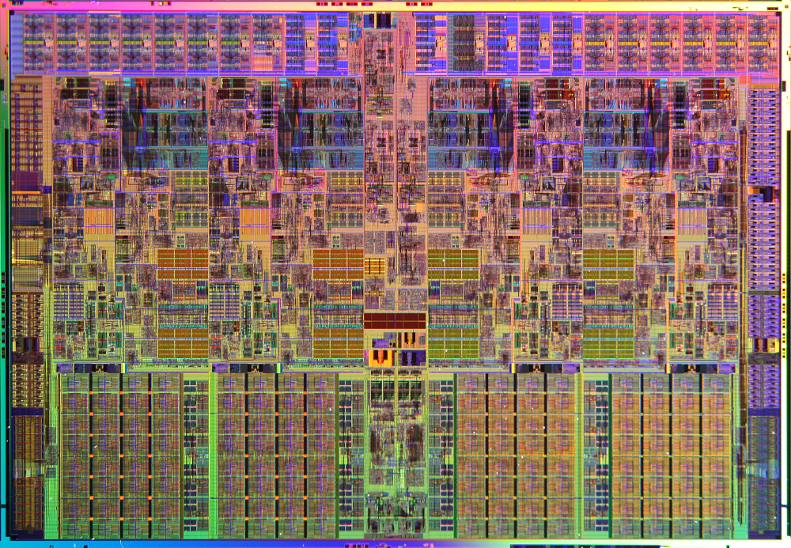
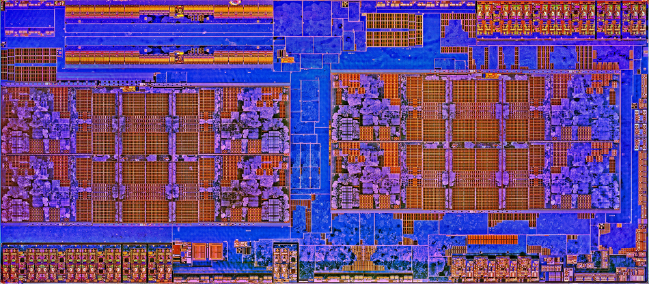
All three processors run the exact same programs…
but they're TOTALLY different on the inside
I’m an x86 CPU!
I’m an x86 CPU!
VIA Nano
AMD Zen
I’m an x86 CPU!
Intel Core i7

Slide 18
Kinds of ISAs: CISC
CISC: "Complex Instruction Set Computer"
ISA designed for humans to write asm
from the days before compilers!
writing compilers for these is hard.
lots of instructions and ways to use them
complex (multi-step) instructions to shorten and simplify programs
"search a string for a character"
"copy memory blocks"
"check the bounds of an array access"
x86 is very CISCy
prguitarman.com

Slide 19
Kinds of ISAs: RISC
RISC: "Reduced Instruction Set Computer"
ISA designed to make it easy to:
build the CPU hardware
make that hardware run fast
write compilers that make machine code
a small number of instructions
instructions are very simple
MIPS is very RISCy
MIPS and RISC were the original RISC architectures developed at two universities in California
the research leads were… Patterson and Hennessy…

Slide 20
Popular ISAs today
x86 (today, it’s x86-64 or “x64” for short)
most laptops/desktops/servers have one
ARM
almost everything else has one, now including modern Apples
Every other ISA: Alpha, Sparc, POWER/PPC, z, z80, 29K, 68K, 8051, PIC, AVR, Xtensa, SH2/3/4, 68C05, 6502, SHARC, MIPS...
microcontrollers
mainframes
some video game consoles
historical/legacy applications
"legacy" = "no one makes new things with it anymore, but we maintain the things that still use it"
Notes:
- modern x86 CPUs are, essentially, RISC CPUs that can read the weird x86 instructions
- you'd be amazed how many things are still being run by some old IBM PC or Commodore 64 sitting in a closet somewhere

Slide 21
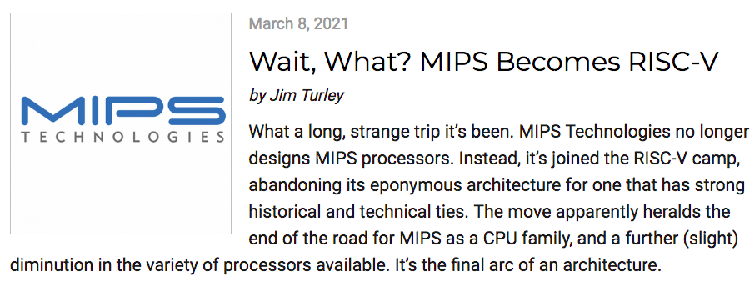
So here's an interesting thing that happened
as of 2021:

Slide 22
Wait, then why is this class in MIPS??
despite its limited use today, MIPS has been incredibly influential!
almost every architecture created after MIPS works like MIPS.
RISC-V is almost identical to MIPS in every way that matters.
x86 is pretty much the only holdout from the old CISC days.
CS classes are not about giving you résumé-friendly qualifications in specific technologies. you're here to learn about computer architecture, not MIPS.
we are using MIPS as a tool to teach the "what" and the "why," and ultimately, that's what you should be focusing on.
Notes:
pssst spoilers: we're not learning 100% real MIPS either. ;)
also we’re almost certainly switching to RISC-V in the future too!

